Slide 1
Channel Simulation of High-Speed Serial (HSS) Systems
James Zhou, Sheldon Tan
21-DEC-2012

Slide 2
HSS Channel Model
Bit Source
Tx FFE
Tx AEQ
Tx Package
Passive link
Modulator
repeater
Passive link
Rx Package
Rx AEQ
Rx DFE
Sampler
CDR
Analog blocks are concatenated in frequency-domain to form a single block; Its impulse response is used for time-domain analysis.
Tx FFE and Rx DFE/CDR models are provided in IBIS AMI format.
Bit source, modulator and sampler are implemented in EDA tool.

Slide 3
System Description
Channel simulation data shown in following slides are obtained for a 45 inch channel running at 10Gbps.

Slide 4
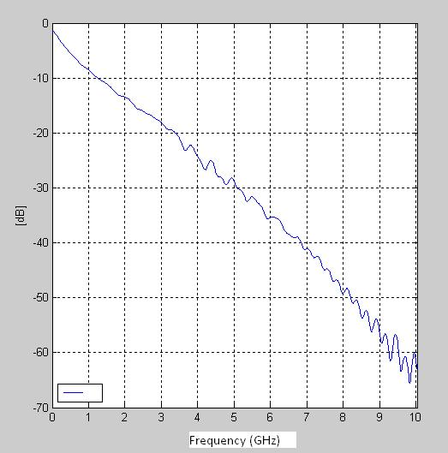
Frequency Response
Cascaded frequency response of analog channel

Slide 5
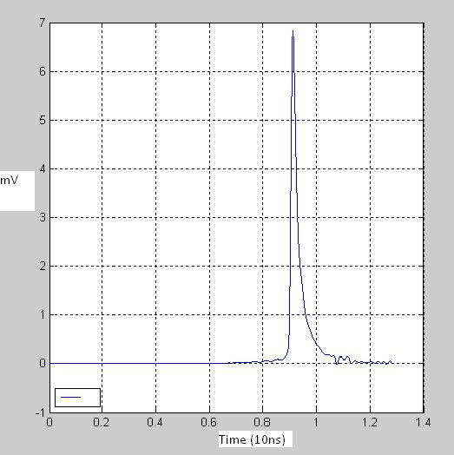
Impulse Response
Impulse response obtained from channel frequency response

Slide 6
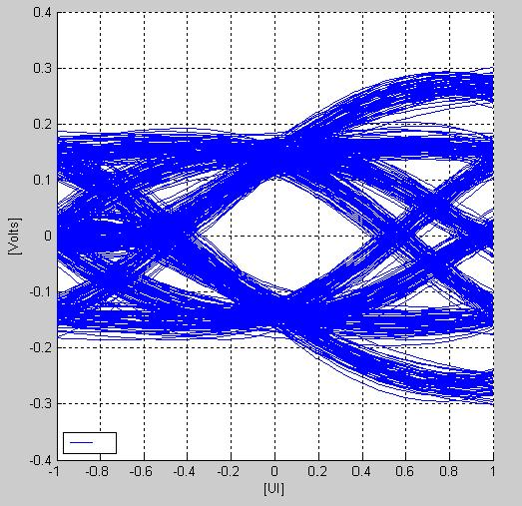
Rx Sampler Eye-Diagram

Slide 7
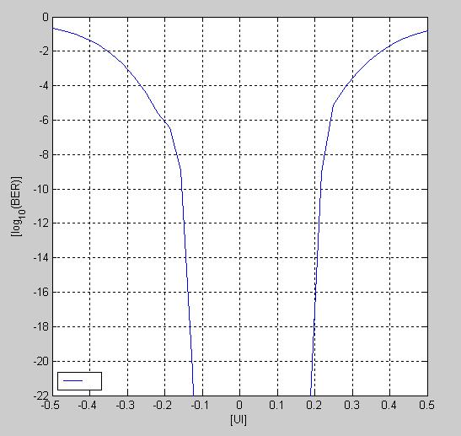
Bit Error Rate

Slide 8
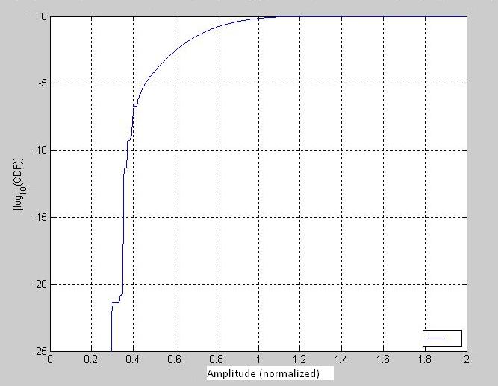
Cumulative Probability Distribution Function

